Slide 1
CSE322
Pushdown Automata: Deterministic Pushdown Automata and non-deterministic Pushdown Automata
&
Context free languages and Pushdown Automata
Lecture #32

Slide 2

Pushdown Automata and Context Free Language
The set accepted by pda are Context Free Language.
So For Pda we can draw CFL and for given CFL we can draw Pda.
Construction of Pda for Given CFL

Slide 3
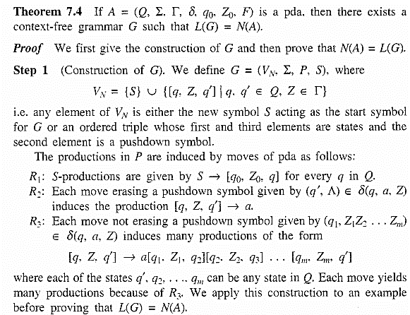
Construction of CFL for given PDA
Notes:
Construction of CFL for given PDA

Slide 4
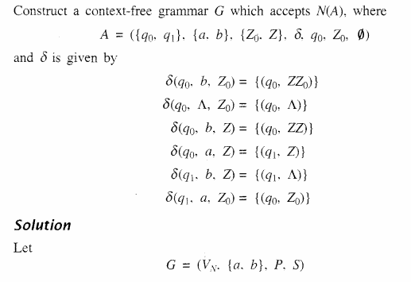
EXAMPLE
Notes:
EXAMPLE

Slide 5
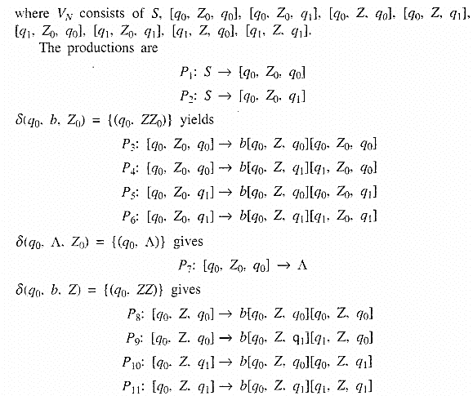

Slide 6
